Slide 1
Name service

Slide 2
Outline
General concepts
Domain Name System (DNS)
Directory and Discovery Services
  Introduction
  Jini
  Global Name Service (GNS)
  X500 Directory Service
VFSTR

Slide 3
Introduction
In a distributed system names are used to refer to a wide variety of resources such as computers, services, remote objects, and files as well as users.
Names facilitate communication and resource sharing.
Names are used for identification as well as for describing attributes.
For many purposes, names are preferable to identifiers
  because the binding of the named resource to a physical location is deferred and can be changed
  because they are more meaningful to users
VFSTR
Notes:
Names (e.g. URLs) are bound to objects (e.g. web pages). Names must be resolved before the corresponding objects can be invoked. The use of addresses as names is deprecated because it prevents the relocation of the named objects.

Slide 4
Names, Addresses and other attributes
Any process that requires access to a specific resource must possess a name or identifier for it. Ex: URL http:://www.cdk3.net/
A name has to be looked up before it can be used.
A name is said to be resolved when it is translated into data about the resource or object.
VFSTR

Slide 5
Names and Binding
Names are bound to the attributes of named objects (and not to any specific implementations.)
The association between a name and an object is called binding.
Services are written to map between names and the attributes of objects they refer to.
Example: domain name→ Domain name Service (DNS) maps → attributes of the host computer
VFSTR

Slide 6
Composed naming domains used to access a resource from a URL
Figure 9.1
URL
http://www.cdk3.net:8888/WebExamples/earth.html
DNS lookup
Resource ID (IP number, port number, pathname)
138.37.88.61
8888
WebExamples/earth.html
ARP lookup
(Ethernet) Network address
2:60:8c:2:b0:5a
file
VFSTR
Socket
Web server
*

Slide 7
Name Service
A name service stores a collection of one or more naming contexts – sets of bindings between textual names and attributes for objects.
Provides a general naming scheme for entities (such as users and services) that are beyond the scope of a single service.
Major operation: resolve a name - to look up attributes from a given name
Other operations required: creating new binding, deleting bindings, listing bound names and adding and deleting contexts.
VFSTR

Slide 8
General Name Service Requirements
  Handle arbitrary number of names and to serve arbitrary number of administrative organizations.
  A long lifetime
  High availability
  Fault isolation
  Tolerance of mistrust
VFSTR

Slide 9
Design Issues
Name spaces
Name Resolution
The domain name system
VFSTR

Slide 10
Name Spaces
A name space is a collection of all valid names recognized by a particular service
Allow simple but meaningful names to be used
Potentially infinite number of names
Structured
  to allow similar subnames without clashes
  to group related names
Allow re-structuring of name trees
  for some types of change, old programs should continue to work
Management of trust
VFSTR

Slide 11
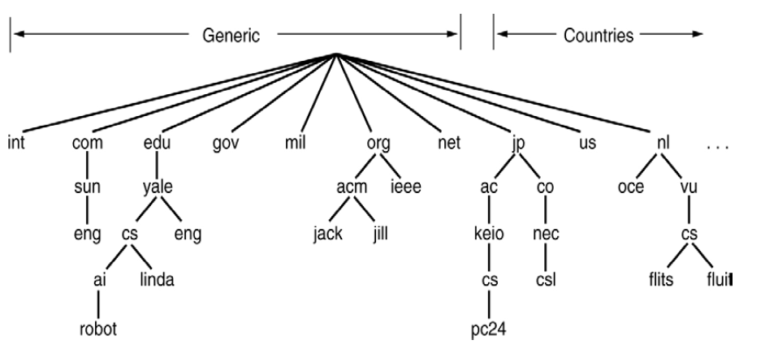
Name Space
VFSTR

Slide 12
Name Resolution
Resolution is an iterative process whereby a name is repeatedly presented to the naming contexts.
The name is first presented to some initial naming context; resolution iterates as long as further context and derived names are output.
Example1: /etc/passwd in which ‘etc’ is presented to context / and ‘passwd’ is presented to context /etc.
Example 2: www.dcs.qmw.ac.uk in which the alias is resolved to another domain name such as copper.dcs.qmw.ac.uk which is further resolved to produce IP address.
VFSTR
Notes:
Name resolution in the presence of cooperating name servers is called navigation and may be performed by the client or by the server.

Slide 13
Name Servers and Navigation
Any name service stores a very large database.
Data is partitioned into servers according to its domain.
Partitioning of the data implies that the local name server cannot answer all the enquiries without the help of other name servers.
Process of locating naming data from among more than one name server in order to resolve a name is called navigation. Ex: Iterative Navigation model(DNS)
VFSTR

Slide 14
Iterative navigation
NS2
2
Name
1
NS1
servers
Client
3
NS3
A client iteratively contacts name servers NS1–NS3 in order to resolve a name
VFSTR

Slide 15
Non-recursive and recursive server-controlled navigation
Figure 9.3
NS2
NS2
2
2
1
4
3
NS1
1
NS1
client
client
4
3
5
NS3
NS3
Non-recursive
Recursive
server-controlled
server-controlled
A name server NS1 communicates with other name servers on behalf of a client
DNS offers recursive navigation as an option, but iterative is the standard technique. Recursive navigation must be used in domains that limit client access to their DNS information for security reasons.
VFSTR
*

Slide 16
Caching
Client name resolution software and servers maintain a cache of previous name resolutions.
How long a resolver caches a DNS response (i.e. how long a DNS response remains valid) is determined by a value called the time to live.
Server may use data from its own cache or other server cache it is authorized to access.
Caching is key to performance and fault tolerance.
VFSTR

Slide 17
The Domain Name System
A distributed naming database
Name structure reflects administrative structure of the Internet
Rapidly resolves domain names to IP addresses
  exploits caching heavily
  typical query time ~100 milliseconds
Scales to millions of computers
  partitioned database
  caching
Resilient to failure of a server
  replication
VFSTR
Notes:
The Domain Name System resolves names on a world-wide scale and represents a considerable engineering achievement.

Slide 18
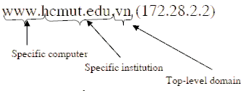
Parts of a domain name
Usually consists of two or more parts (technically labels), separated by dots. .
The rightmost label conveys the top-level domain.
Each label to the left specifies a subdivision, or subdomain of the domain above it.
VFSTR

Slide 19
DNS name servers
The Domain Name System consists of a hierarchical set of DNS servers
Each domain or subdomain has one or more authoritative DNS servers that publish information about that domain and the name servers of any domains "beneath" it
The hierarchy of authoritative DNS servers matches the hierarchy of domains.
At the top of the hierarchy stand the root nameservers: the servers to query when looking up (resolving) a top-level domain name
VFSTR

Slide 20
Basic DNS algorithm for name resolution
Look for the name in the local cache
Try a superior DNS server, which responds with:
  another recommended DNS server
  the IP address (which may not be entirely up to date)
VFSTR

Slide 21
DNS name servers
Figure 9.4
a.root-servers.net
(root)
uk
ns1.nic.uk
purdue.edu
Note: Name server names are in italics, and the corresponding domains are in parentheses.
Arrows denote name server entries
(uk)
yahoo.com
....
ns.purdue.edu
co.uk
(purdue.edu)
ac.uk
...
ns0.ja.net
(ac.uk)
* .purdue.edu
ic.ac.uk
authoritative path to lookup:
jeans-pc.dcs.qmw.ac.uk
qmw.ac.uk
...
alpha.qmw.ac.uk
dns0.dcs.qmw.ac.uk
dns0-doc.ic.ac.uk
(qmw.ac.uk)
(dcs.qmw.ac.uk)
(ic.ac.uk)
dcs.qmw.ac.uk
*.dcs.qmw.ac.uk
*.ic.ac.uk
*.qmw.ac.uk
VFSTR
*

Slide 22
DNS in typical operation
a.root-servers.net
Without caching
(root)
uk
ns1.nic.uk
purdue.edu
(uk)
yahoo.com
....
ns.purdue.edu
co.uk
(purdue.edu)
ac.uk
...
ns0.ja.net
(ac.uk)
* .purdue.edu
ic.ac.uk
qmw.ac.uk
...
IP: alpha.qmw.ac.uk
2
alpha.qmw.ac.uk
dns0.dcs.qmw.ac.uk
dns0-doc.ic.ac.uk
client.ic.ac.uk
(qmw.ac.uk)
(dcs.qmw.ac.uk)
(ic.ac.uk)
IP:jeans-pc.dcs.qmw.ac.uk
IP:ns0.ja.net
dcs.qmw.ac.uk
*.dcs.qmw.ac.uk
*.ic.ac.uk
1
4
*.qmw.ac.uk
jeans-pc.dcs.qmw.ac.uk ?
VFSTR
3
IP:dns0.dcs.qmw.ac.uk
*
Notes:
Animation: reveals each step in looking up jeans-pc.dcs.qmw.ac.uk from a client in the ic.ac.uk domain
Discuss how caching reduces the number of steps.

Slide 23
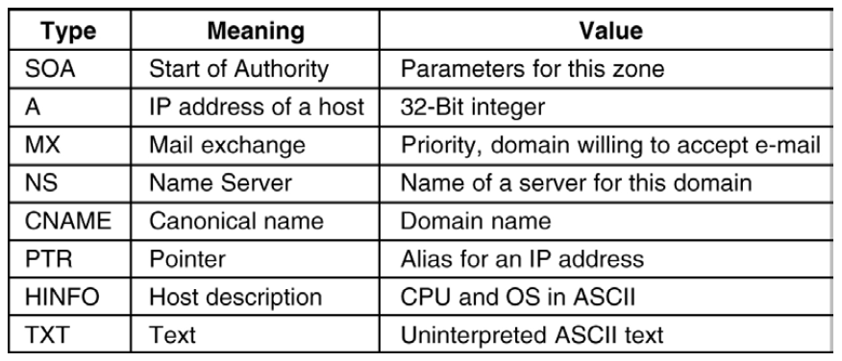
Resource Records
VFSTR

Slide 24
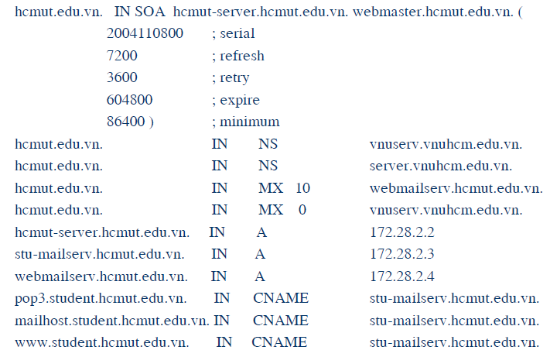
Example of resource record
VFSTR

Slide 25
DNS issues
Name tables change infrequently, but when they do, caching can result in the delivery of stale data.
  Clients are responsible for detecting this and recovering
Its design makes changes to the structure of the name space difficult. For example:
  merging previously separate domain trees under a new root
  moving subtrees to a different part of the structure (e.g. if Scotland became a separate country, its domains should all be moved to a new country-level domain.
VFSTR

Slide 26
Directory and Discovery Services
Directory services
  Attribute-based name services
  Attributes are used as values to be looked up
  Textual name can be considered to be just another attribute
VFSTR

Slide 27
Directory and Discovery Services
Discovery services
  Directory service that registers services provided in a spontaneous networking environment
  Provide an interface for automatically registering and de-registering services, as well as an interface for clients to look up the services they require
  Ex : a printer (or the service that manages it) may register its attributes with the discovery service as follows :
    ‘resourceClass = printer, type=laser, color=yes, resolution=600dpi, location=room101, url=http://www.hotelNW.com/services/printer98’
VFSTR

Slide 28
Jini Discovery Service
Designed to be used for spontaneous networking
Entirely java-based
Computers communicate by means of RMI, and can download code if necessary
Discovery-related components in a Jini system are look up services
A Jini service (such as printing service) may be registered with many look up services
VFSTR

Slide 29
Jini Discovery Service
How to locate the look up service ?
  Using a well-known multicast IP address
  Multicast the request using a “time to live” value
  Look up services announce their existence to the same multicast address
Service instance is configured with one or more group names such as ‘finance’, ‘sales’, ‘admin’, which act as scoping labels.
Limited period of time
VFSTR

Slide 30
Service Discovery in Jini
admin
Printing
Client
1. ‘finance’
service
lookup service?
admin
Lookup
Client
service
Network
2. Here I am: .....
4. Use printing
service
admin, finance
3. Request
Lookup
Corporate
Printing
printing
service
infoservice
service
finance
VFSTR

Slide 31
Global Name Service (GNS)
Designed and implemented by Lampson and colleagues at the DEC Systems Research Center (1986)
Provide facilities for resource location, email addressing and authentication
When the naming database grows from small to large scale, the structure of name space may change
  the service should accommodate it
Cache consistency ?
VFSTR

Slide 32
GNS Structure
Tree of directories holding names and values
Muti-part pathnames refer to the root or relative working directory (like Unix file system)
Unique Directory Identifier (DI)
A directory contains list of names and references
Leaves of tree contain value trees (structured values)
VFSTR

Slide 33
GNS directory tree and value tree
DI: 599
(EC)
DI: 543
UK
FR
DI: 574
DI: 437
AC
DI: 322
QMW
Peter.Smith
mailboxes
password
Alpha
Beta
Gamma
VFSTR

Slide 34
Accommodating changes
DI: 633
(WORLD)
Well-known directories:
#599 = #633/EC
#642 = #633/NORTH AMERICA
EC
NORTH AMERICA
DI: 599
DI: 642
UK
FR
US
CANADA
DI: 543
DI: 574
DI: 732
DI: 457
How to integrate naming trees of two previously separate GNS services
But what is for ‘/UK/AC/QMV, Peter.Smith’ ?
VFSTR

Slide 35
Using DI to solve changes
DI: 633
(WORLD)
Well-known directories:
#599 = #633/EC
#642 = #633/NORTH AMERICA
EC
NORTH AMERICA
DI: 599
DI: 642
UK
FR
US
CANADA
DI: 543
DI: 574
DI: 732
DI: 457
Using the name ‘#599/UK/AC/QMV, Peter.Smith’
VFSTR

Slide 36
Restructuring of database
DI: 633
(WORLD)
Well-known directories:
#599 = #633/EC
#642 = #633/NORTH AMERICA
EC
NORTH AMERICA
DI: 599
DI: 642
UK
FR
US
US
CANADA
DI: 543
DI: 574
DI: 732
DI: 457
#633/EC/US
Using symbolic links
VFSTR

Slide 37
X500 Directory Service
Standard of ITU and ISO organizations
Organized in a tree structure with name nodes as in the case of other name servers
A wide range of attributes are stored in each node
Directory Information Tree (DIT)
Directory Information Base (DIB)
VFSTR

Slide 38
X.500 service architecture
DUA
DSA
DSA
DUA
DSA
DSA
DSA
DUA
DSA
Directory Server Agent (DSA)
Directory User Agent (DUA)
VFSTR

Slide 39
An X.500 DIB Entry
info
Alice Flintstone, Departmental Staff, Department of Computer Science,
University of Gormenghast, GB
commonName
uid
Alice.L.Flintstone
alf
Alice.Flintstone
Alice Flintstone
mail
A. Flintstone
alf@dcs.gormenghast.ac.uk
surname
Alice.Flintstone@dcs.gormenghast.ac.uk
Flintstone
roomNumber
telephoneNumber
Z42
+44 986 33 4604
userClass
Research Fellow
VFSTR

Slide 40
Part of the X.500 Directory Information Tree
X.500 Service (root)
...
France (country)
Great Britain (country)
Greece (country)
...
...
BT Plc (organization)
University of Gormenghast (organization)
...
...
Computing Service (organizationalUnit)
Department of Computer Science (organizationalUnit)
Engineering Department (organizationalUnit)
...
...
Departmental Staff (organizationalUnit)
ely (applicationProcess)
Research Students (organizationalUnit)
...
...
Alice Flintstone (person)
...
Pat King (person)
James Healey (person)
Janet Papworth (person)
...
VFSTR

Slide 41
Future of X500
Not clear
  Privacy issues
  Need to be integrated with existing Internet Standards (DNS)
  Uniformity for object classes
VFSTR

Slide 42
References
Distributed Systems: Concepts and Design
Internet sources
  http://www.cdk3.net
  wiki
VFSTR

